Slide 1

Beliefs, Heuristics, biases and strategic choices
Dr.R.Gayathri
Faculty,SoM,SASTRA

Slide 2
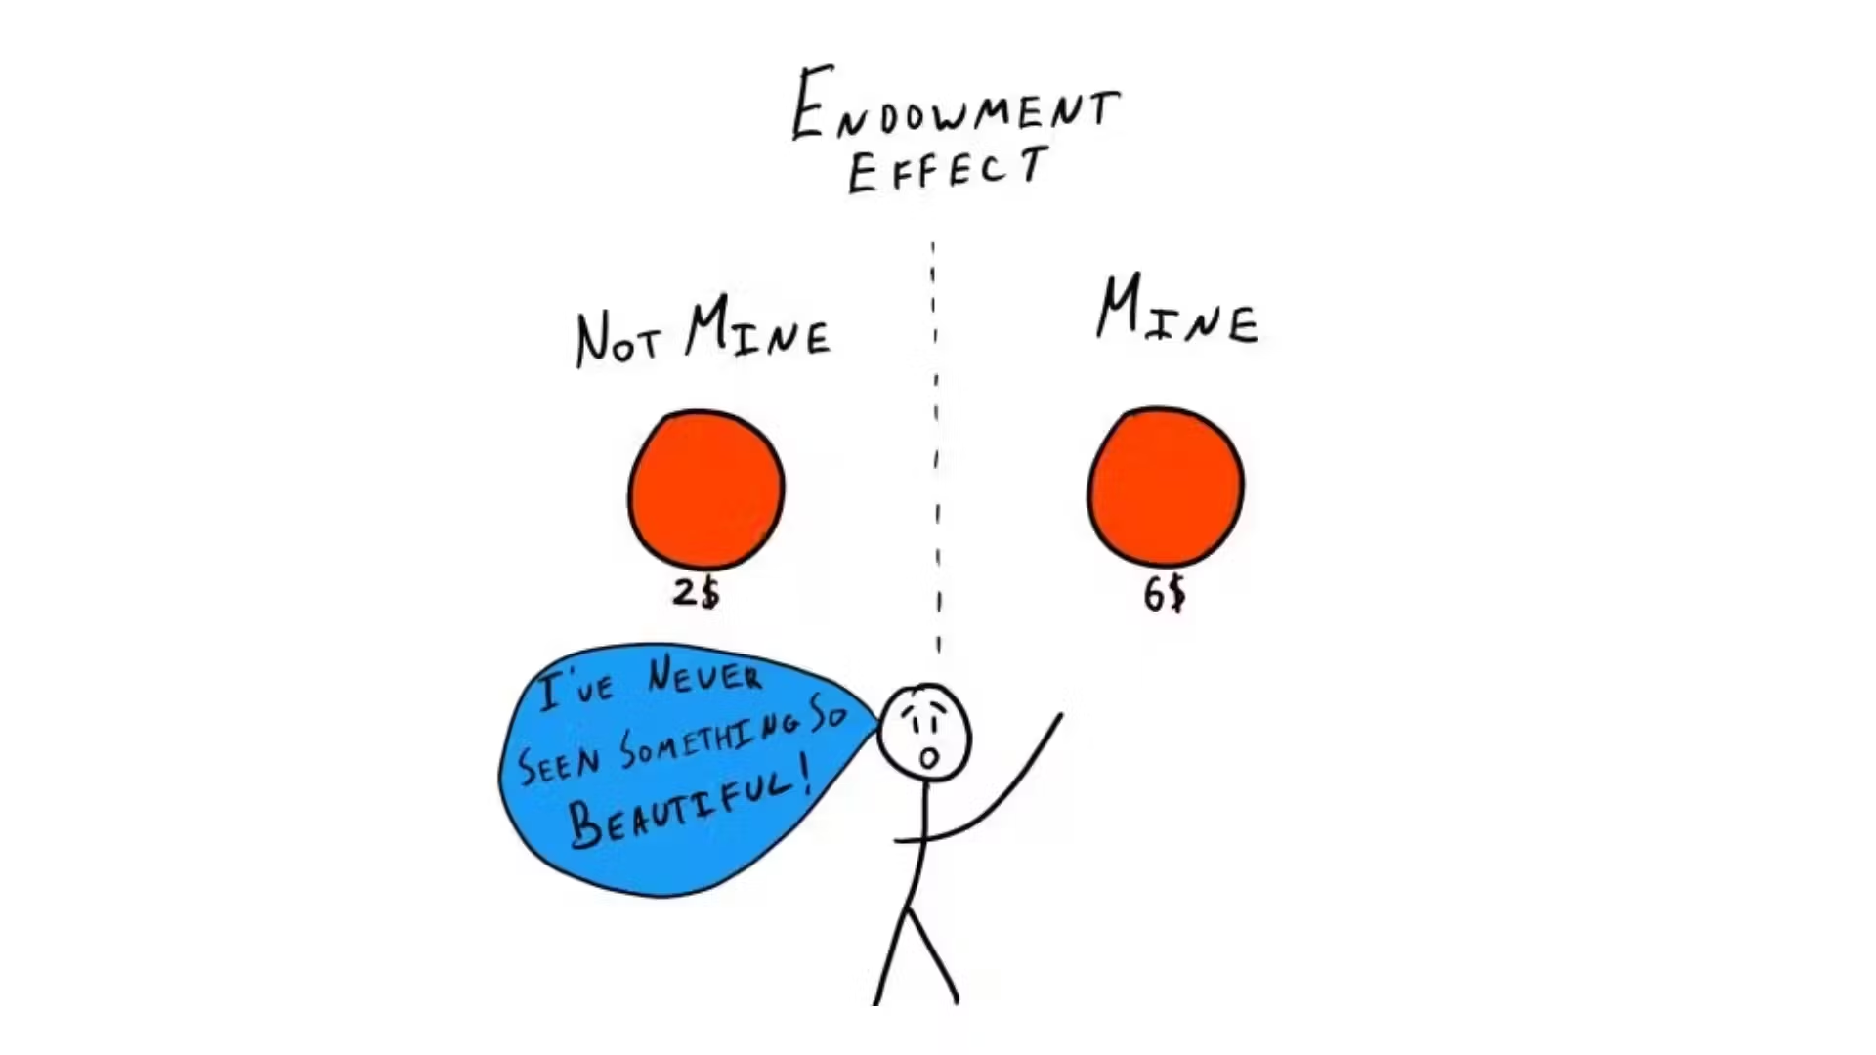
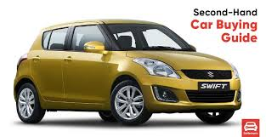

Slide 3
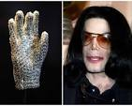
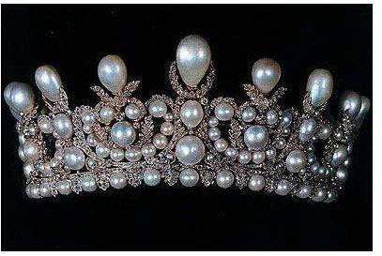
Understanding Value and Utility
Michael Jackson's white glove sold for $350,000 at a Julien's auction in 2009. The glove was worn by Jackson when he first performed the moonwalk in 1983.
Pearl and diamond tiara commissioned by Napoleon III: Worn by Princess Gloria at her wedding

Slide 4
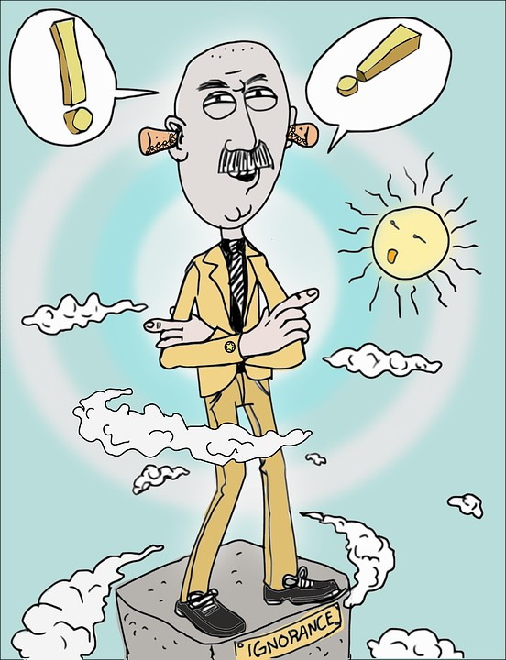

Slide 5
Revisiting rationality
Traditional Economic Models: Assume individuals make decisions to maximize utility based on stable preferences.
Behavioral Economics Perspective: Highlights deviations from rationality due to psychological factors.
Example: The endowment effect, where individuals value owned items higher than their market value.

Slide 6
Beliefs & Biases
The most significant implication of using heuristics is that they often result in biases, meaning systematic errors. In terms of beliefs, these errors are factual; biases can also occur in terms of preferences, where the errors may result in non-optimal choices.

Slide 7


Lotteries and Utility
Imagine a lottery with a 1% chance of winning $1 million and a 99% chance of winning nothing.
For a risk-averse person, the utility of winning $1 million might not be significantly higher than the utility of their current wealth, so even though the potential payout is large, the low probability makes the expected utility of playing the lottery relatively low.

Slide 8
Lotteries and Expected Utility
In expected utility theory, a lottery represents a gamble with various possible outcomes, each assigned a specific probability, and individuals are assumed to choose the lottery that provides the highest "expected utility" based on their personal assessment of the utility of each outcome and its probability, essentially meaning they choose the option that maximizes their overall satisfaction considering the risk involved; this is often used to explain why people buy lottery tickets despite the low odds of winning, as the potential for a large payout outweighs the small cost of the ticket in their personal utility calculation.

Slide 9
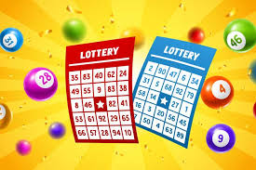
Research in behavioral economics has shown that people often deviate from the "rational" decision-making assumed by the theory, exhibiting biases like overestimating small probabilities which can explain why people sometimes buy lottery tickets even when the expected value is negative.
Besides explaining lottery behavior, expected utility theory is used in various fields like finance, insurance, and healthcare decision-making to analyze choices under uncertainty.

Slide 10

Allais Paradox
Scenario 1 : You must choose between:
Option A: A guaranteed $1 million.
Option B: A 10% chance of winning $5 million, an 89% chance of winning $1 million, and a 1% chance of winning nothing.
Scenario 2:You must choose between:
Option C: A 10% chance of winning $5 million and a 90% chance of winning nothing.
Option D: An 11% chance of winning $1 million and an 89% chance of winning nothing.

Slide 11

How People Typically Choose
In Scenario 1, most people prefer Option A (the sure $1 million).
In Scenario 2, most people prefer Option C (higher potential reward).

Slide 12
Why Is This Irrational?
According to Expected Utility Theory, choices should be consistent, meaning that if someone chooses Option A in Scenario 1, they should choose Option D in Scenario 2 (since the probabilities are proportionally the same).
However, people switch their choices due to certainty effect: In Scenario 1, people overvalue the certainty of getting $1 million. In Scenario 2, when certainty is removed, they focus on maximizing potential gains, even if probabilities are low.
This paradox challenges the fundamental assumption of rational choice theory by showing that people's decisions depend on how probabilities are framed, rather than strictly on expected value calculations.

Slide 13
Recent Real-World Examples of the Allais Paradox
Lottery vs. Insurance (2023 Study on Risk Preferences)A study in 2023 found that people frequently overpay for insurance (due to certainty effect) while simultaneously purchasing lottery tickets, even when the probabilities of both events suggest the opposite behavior.
Insurance: Many people overpay for extended warranties on electronics, despite the low probability of needing repairs.
Lotteries: The same people spend money on lotteries, despite near-zero probability of winning, because they are drawn to the small chance of a huge gain.

Slide 14
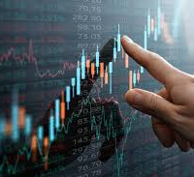
Investment Behavior in Stock Markets
A 2022 study found that: Investors avoid selling profitable stocks too early (due to loss aversion and certainty effect).
However, when presented with high-risk stocks with very low chances of extreme returns, they over-invest, behaving inconsistently with expected utility principles.

Slide 15

COVID-19 Vaccination Decisions
During the pandemic, many individuals hesitated to take vaccines due to overweighting the low probability of side effects, while ignoring the much higher probability of severe illness. This follows the Allais paradox, where people overvalue certainty (avoiding the vaccine risk) over a rational probability-based choice.

Slide 16
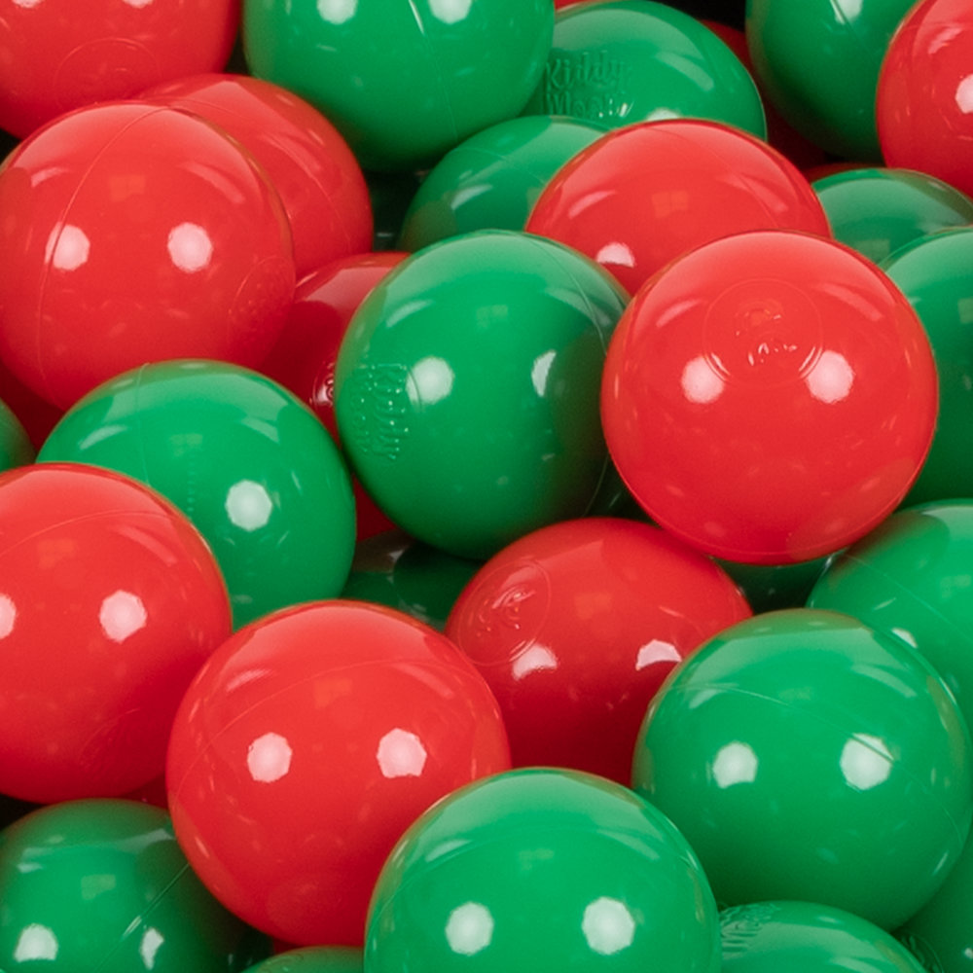
The Ellsberg paradox
The Ellsberg Paradox, introduced by Daniel Ellsberg in 1961, highlights people's preference for known risks over ambiguous (unknown) risks, contradicting expected utility theory.
This paradox demonstrates ambiguity aversion, where individuals tend to choose options with known probabilities rather than those with uncertain probabilities, even when expected values are similar.
"A known devil is better than an unknown angel"

Slide 17
Real world examples
Example: Cryptocurrency vs. Traditional Investments (2023 Study on Risk Preferences)
Many investors avoid Bitcoin and cryptocurrencies because they perceive the risks as ambiguous, even though the historical average return is higher than traditional stocks. Instead, they prefer low-yield bonds or index funds, despite inflation reducing their real value.

Slide 18

Example 2. Job Market and Career Choices
Many individuals prefer a stable low-paying job over a high-paying startup position, fearing the uncertainty of job security. Even when presented with data showing startups often offer higher long-term earnings, people avoid them due to ambiguity aversion.

Slide 19
Applications
Ambiguity Aversion: People prefer known risks over unknown risks, even if the expected outcome is the same or better.
Policy Implications: Governments and businesses can improve risk communication by reducing ambiguity in public health, finance, and insurance decisions.
Understanding the paradox helps in designing better policies, financial products, and marketing strategies to address consumer concerns.

Slide 20
Causes of irrationality
Irrationality in decision-making is influenced by various psychological, emotional, social, and cognitive factors. These causes explain why individuals deviate from purely rational behavior, leading to suboptimal or seemingly illogical choices.
Baumeister (2001) has identified five different causes of irrational, or what he terms self-defeating, behavior. We can really equate self-defeating behavior with behavior that is not in a person’s long-run self-interest.

Slide 21
Cognitive Biases- Cognitive biases are systematic errors in thinking that affect judgments and decisions.
Example: Overconfidence Bias – Investors frequently overestimate their knowledge, leading to excessive trading and losses.
Social and Peer Influences - People are highly influenced by their social environment, leading to herd behavior and conformity bias.
Example: Bandwagon Effect – Individuals follow the crowd rather than making independent choices.
Recent Example (2021-2023 Trends in Cryptocurrency)Many people invested in Dogecoin and meme stocks due to social media hype, even when fundamental valuations were weak.

Slide 22
emotional distress
threatened egotism
self-regulation failure
rejection
belongingness, and decision fatigue

Slide 23
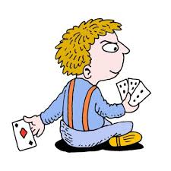
Emotional distress
There has been a lot of research into the effects of emotions on decision-making. The conventional attitude taken by economists, and also by philosophers in the Kantian tradition, is that emotions tend to cloud good judgment, resulting in ‘irrational’ decisions or self-defeating behavior

Slide 24

An ‘emotional’ person on the other hand would be angry with the cheat and take steps to gain revenge, at risk and cost to himself, which the ‘rational’ person would be unwilling to take.
This is an example of what is called a ‘reputation effect’ emotional people may gain a reputation for not standing for any nonsense or backsliding in their dealings, thus encouraging others to be straight with them.

Slide 25
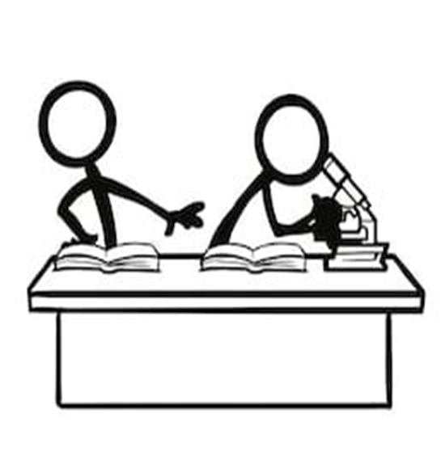
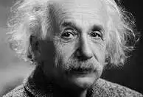
Emotions are indeed a two-edged sword
Our emotions can backfire on us, referring to them as ‘doomsday devices’, The problem with doomsday devices is that they cannot be disarmed, even if they are activated by mistake and will explode regardless of the consequences and may lead to futile and self-destructive reactions; a well-known example is the successive rounds of retaliation that occur with feuds between gangs or clans.

Slide 26
Threatened Egoism and Decision-Making
Threatened egoism occurs when individuals perceive a challenge to their self-esteem or status, leading to defensive behaviors that may be economically irrational.

Slide 27
Self deception
Self-deception is an important category of irrational behavior, as we have seen. It can be the result of a type of emotional distress

Slide 28
Threat to self-esteem
There appears to be a relationship between low self esteem and self-defeating behavior such as self-handicapping, binge eating and alcohol abuse.

Slide 29


The ‘peacock’s tail’ syndrome
People with high, but misplaced, self-esteem may also indulge in alcohol and drug abuse, believing that they are strong enough to withstand the harmful physical effects and the tendency to addiction. This can be referred to as the ‘peacock’s tail’ syndrome,

Slide 30

Cognitive dissonance
This theory states that people are motivated to avoid having their attitudes and beliefs in a dissonant or conflicting relationship, and they feel uncomfortable when dissonance occurs.
This discomfort can cause people to do many things that could be classed as irrational.
Thus cognitive dissonance generally involves people justifying their actions by changing their beliefs. This is because it is often easier to change one’s beliefs than to change actions that have already been taken.

Slide 31
Memory
Emotional states over time are concerned there are two important factors that need to be discussed, in terms of both their causes and their implications:
1 People tend to revert to a ‘normal emotional state’ after any kind of emotional experience, whether it be pleasant or unpleasant.
2 People tend to overestimate the length of time that it will take to revert to this normal state.

Slide 32
Decision fatigue
It seems that people not only tire when it comes to self-control, they also tire of making decisions in general.

Slide 33
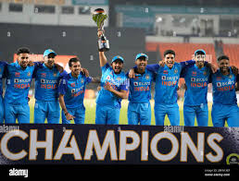
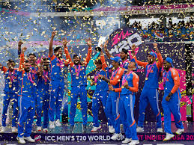
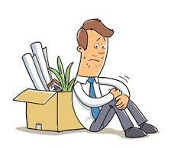
Interpersonal rejection
People feel rejected socially, this appears to be such a psychological blow that they cease to function effectively in a number of ways.
It is likely that rejection causes a change in the body’s output of hormones and neurotransmitters. Research has already established for example that winning teams and their supporters both enjoy an increase in testosterone output following victory, while losers and their supporters suffer from a drop in testosterone.

Slide 34
Types of biases and beliefs
The most significant implication of using heuristics is that they often result
in biases, meaning systematic errors. In terms of beliefs, these errors are factual; biases can also occur regarding preferences, where the errors may result in non-optimal choices.
There are four main sources of deviations from the standard model: self-evaluation bias, incorrect probability estimation, projection bias and magical beliefs.

Slide 35
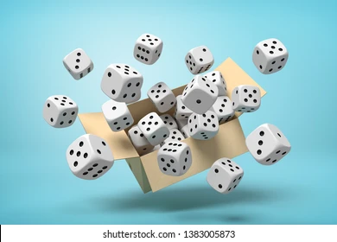
Bayesian probability estimation
This means that people are able to estimate probabilities correctly, given the relevant information, and in particular are able to update them correctly given a sequence of prior outcomes.

Slide 36
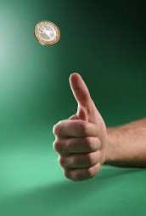
The ‘law of small numbers’ or The ‘gambler’s fallacy’ effect
This effect derives its name from the observation that gamblers frequently expect a certain slot machine or a number that has not won in a while to be ‘due’ to win. The gambler’s fallacy is sometimes referred to as the ‘law of averages’.

Slide 37
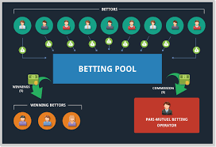
Pari-mutuel betting
There is a variety of empirical evidence supporting the existence of the gambler’s fallacy effect. For example, New Jersey’s pick-three-numbers game is a pari-mutuel betting system; this means that the fewer people bet on a number, the higher is the expected payout.

Slide 38
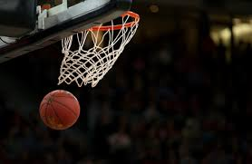
The ‘hot hand’ effect
This effect derives its name from the mistaken belief among basketball players and fans that a player’s chance of hitting a shot is greater following a hit than following a miss on the previous shot.

Slide 39
Self-evaluation bias
This factor is sometimes described in terms of overconfidence, but we shall see that, while overconfidence is an important aspect, there are other aspects, including its opposite, under confidence.
It is useful to distinguish between three different kinds of overconfidence since this helps to explain apparent inconsistencies in empirical findings, and we will follow the classification proposed by Moore and Healy (2008). This involves the concepts of overestimation, over-placement, and over-precision.

Slide 40
Overestimation -This relates to overestimation of one’s actual ability, performance, level of control or chance of success.
Overplacement - This aspect of overconfidence is sometimes referred to as the ‘better-than-average’ (BTA) effect: well over half of survey respondents typically rate themselves in the top 50% of drivers.
Overprecision -This refers to excessive certainty regarding the accuracy of one’s beliefs

Slide 41
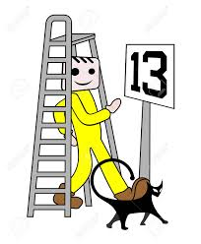
Self-attribution bias
Self-attribution bias is the tendency for individuals to attribute their successes to personal skill, intelligence, or effort while blaming failures on external factors like bad luck or unfair circumstances. This bias can distort learning, decision-making, and self-improvement.

Slide 42

Projection bias
Another kind of bias where people have systematically incorrect beliefs is that they expect their future preferences to be too close to the present ones. For example, we may have learned from experience not to go to the supermarket when we are hungry – we tend to buy all kinds of junk that we don’t normally eat or want to eat, and not only is our bill higher than normal but we also end up with stuff we don’t consume or don’t want to consume.
This happens because at the time of shopping we incorrectly anticipate that our future hunger will be as great as it is now. The term ‘projection bias’ was introduced by Loewenstein, O’Donoghue and Rabin (2003) to describe this phenomenon.

Slide 43
Magical beliefs
This title is a general term for certain irrational beliefs that violate the assumptions of the standard model but do not fit it any of the above three categories. They are often termed ‘superstitions’ in folk psychology. The categories are ‘tempting fate’ and ‘contagion’.
Two interesting biases:
Tempting Fate – The belief that taking unnecessary risks invites negative consequences.
Contagion – The idea that objects, ideas, or behaviors can "transfer" qualities irrationally.

Slide 44
Tempting Fate
People often believe that certain actions increase the likelihood of bad outcomes, even when logically unrelated. Related to superstition, probability neglect, and overgeneralization.
Example: Gambler’s Fallacy – A person who wins multiple rounds at a casino may fear they are "tempting fate" if they continue playing.

Slide 45
Real-World Examples of Tempting Fate
Stock Market Timing: Investors hesitate to re-invest in a stock they previously lost money on, fearing they will tempt fate.
Sports Superstitions: Athletes refuse to change their pre-game rituals, believing it could cause them to lose.
Business Decisions: Some executives avoid launching a new product during a period of corporate bad luck, even if the product is ready.
Health Decisions: People avoid checking their health status (e.g., avoiding doctor visits) fearing bad news will materialize.
Case Study: Apple's "Risk-Averse" Strategy: After the failure of the Apple Newton in the 1990s, Apple avoided entering the tablet market for years, fearing a repeat failure. It finally launched the iPad in 2010, when the risk seemed lower.

Slide 46
Contagion
People believe that objects, behaviors, or beliefs can transfer properties (positive or negative) irrationally.
Driven by associative thinking and emotional biases.
Example: People feel disgusted drinking water from a sterilized glass that once held a cockroach, even if it’s scientifically clean.

Slide 47
Real-World Examples of Contagion
Luxury Branding: Items owned by celebrities (e.g., sneakers worn by Michael Jordan) are perceived as more valuable.
Negative Stigma in Marketing: Products linked to scandals (e.g., Volkswagen after the emissions scandal) experience consumer rejection.
Used Goods Market: People avoid second-hand items associated with tragic events (e.g., houses where murders occurred).
Social Influence & Finance: Fear spreads like a virus in financial markets – if one investor sells, others panic and follow
.Case Study:COVID-19 Panic Buying: During the pandemic, panic spread like contagion, leading to mass purchases of Dettol,sanitizers and essential goods, despite no actual shortages.

Slide 48

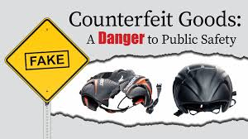
Counterfeit trade
The global trade in counterfeit goods could reach $1.79 trillion by 2030, a 75% increase from that of 2023 and a growth 3.6 times higher than predicted for the global economy

Slide 49
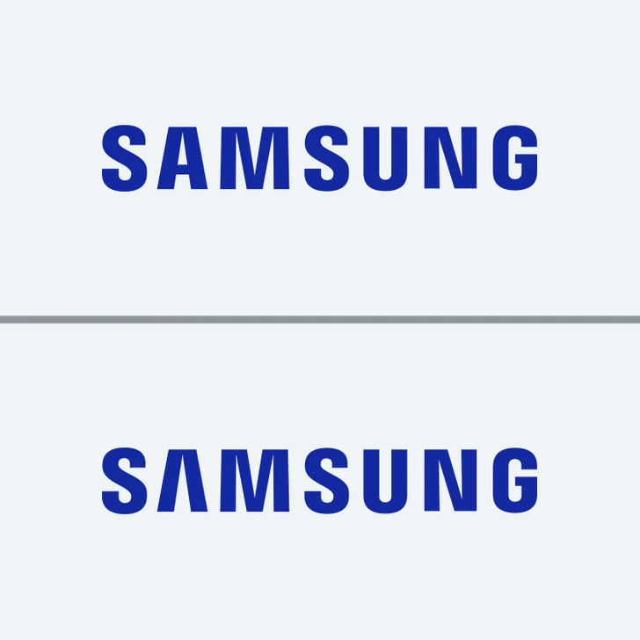
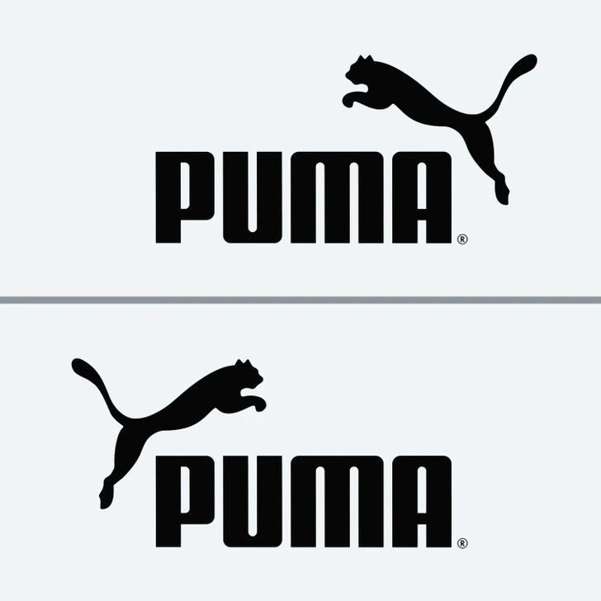



Identify the right logo

Slide 50
Trade in counterfeit goods
Unauthorized representation of a registered trademark carried on goods identical or similar to goods for which the trademark is registered, with a view to deceiving the purchaser into believing that he/she is buying the original goods.
Fake products can be found in a large and growing number of industries, such as common consumer goods, (footwear, cosmetics, toys), business-to-business products (spare parts or chemicals), IT goods (phones, batteries) and luxury items (fashion apparel, deluxe watches). Importantly, many fake goods, particularly pharmaceuticals, food and drink, and medical equipment, can pose serious negative health and safety risks.
While counterfeit and pirated goods originate from virtually all economies in all continents, China and Hong Kong, China continue to be by far the biggest origin.

Slide 51

Consumer Psychology and Demand for Counterfeits
Prospect Theory & Loss Aversion -Consumers tend to overweigh losses and underweigh gains, but when counterfeit products offer a significant price advantage, they may ignore risks.
Perceived vs. Objective Risk - People underestimate the risk of purchasing counterfeits, especially in non-dangerous categories like fashion but not in pharmaceuticals.

Slide 52
Heuristics and Biases in Consumer Decision-Making
Heuristic - If a counterfeit product works well for someone they know, they assume all counterfeits are reliable.
Anchoring Effect- Seeing an expensive branded product first makes the lower-cost counterfeit appear as a "smart buy.
Social Proof & Herd Mentality -If many people buy counterfeits, an individual is more likely to follow the trend.
Endowment Effect - Consumers may irrationally overvalue counterfeit goods they already own, justifying their past decisions.

Slide 53
How to Reduce Demand for Counterfeits?
Nudging consumers towards ethical choices
Clearer labeling of authentic products
Educating consumers on the hidden costs (child labor, organized crime links)
Emphasizing what consumers stand to lose (health risks, financial loss) rather than just legal risks.
Highlighting certainty of getting caught rather than severity of punishment (certainty bias).
Online reviews, blockchain verification, and authentication services to discourage counterfeit trade.

Slide 54
Behavioural finance
Behavioral finance studies how psychological biases and cognitive errors affect financial decision-making.
Key concepts used -
- Overconfidence Bias
Loss Aversion (Prospect Theory - Kahneman & Tversky)
Anchoring Bias
Herd Mentality
Mental Accounting

Slide 55
Market Anomalies Explained by Behavioral Finance
Dot-com bubble (1999-2000)
Housing bubble (2008 crisis)
Cryptocurrency volatility (Bitcoin fluctuations)

Slide 56
Game theory
Game theory was invented to find a theoretical solution to the problems posed by uncertainty in games of chance where rational players make decisions in an interdependent setup.
A ‘Game’ is an abstract of a strategic situation involving interdependence. Players, actions or strategies, and payoffs define the simplest form of the game.
Players: Players are the agents playing the game.
Strategies are the actions or the set of actions available to the players.
Payoffs are the returns to the players at the conclusion of the game.

Slide 57
A Game can be static (called simultaneous-move game) or dynamic (called sequential-move game) depending upon the information base of the players or the time of move of the players.
In simultaneous-move games, neither player knows the other’s action when she(he) decides her own move. In sequential-move games, the players move in sequence and the first-mover does not know the second’s action but the second-mover knows what the first did and the payoffs are decided at the end.

Slide 58

Prisoner’s Dilemma
A well known example of a non-cooperative and a game of complete information is the Prisoners’ Dilemma game.
A crime is committed for which there is no eye witness. Suspects 1 and 2 are caught and imprisoned in two separate cells. Thus each prisoner is in a solitary confinement with no means of communicating with each other.
The magistrate speaks to each prisoner separately, and asks them to act as an informer. If one of them confesses the crime, he will be freed but the other one will spend 4 years in prison.
If both confess, each will spend 3 years in prison. If both stay quiet and do not confess, the crime cannot be probed, so they will get nominal punishment by spending only one year in prison. Thus each player then has two possible strategies: Not confess (N) or Confess (C) and they decide simultaneously.

Slide 59
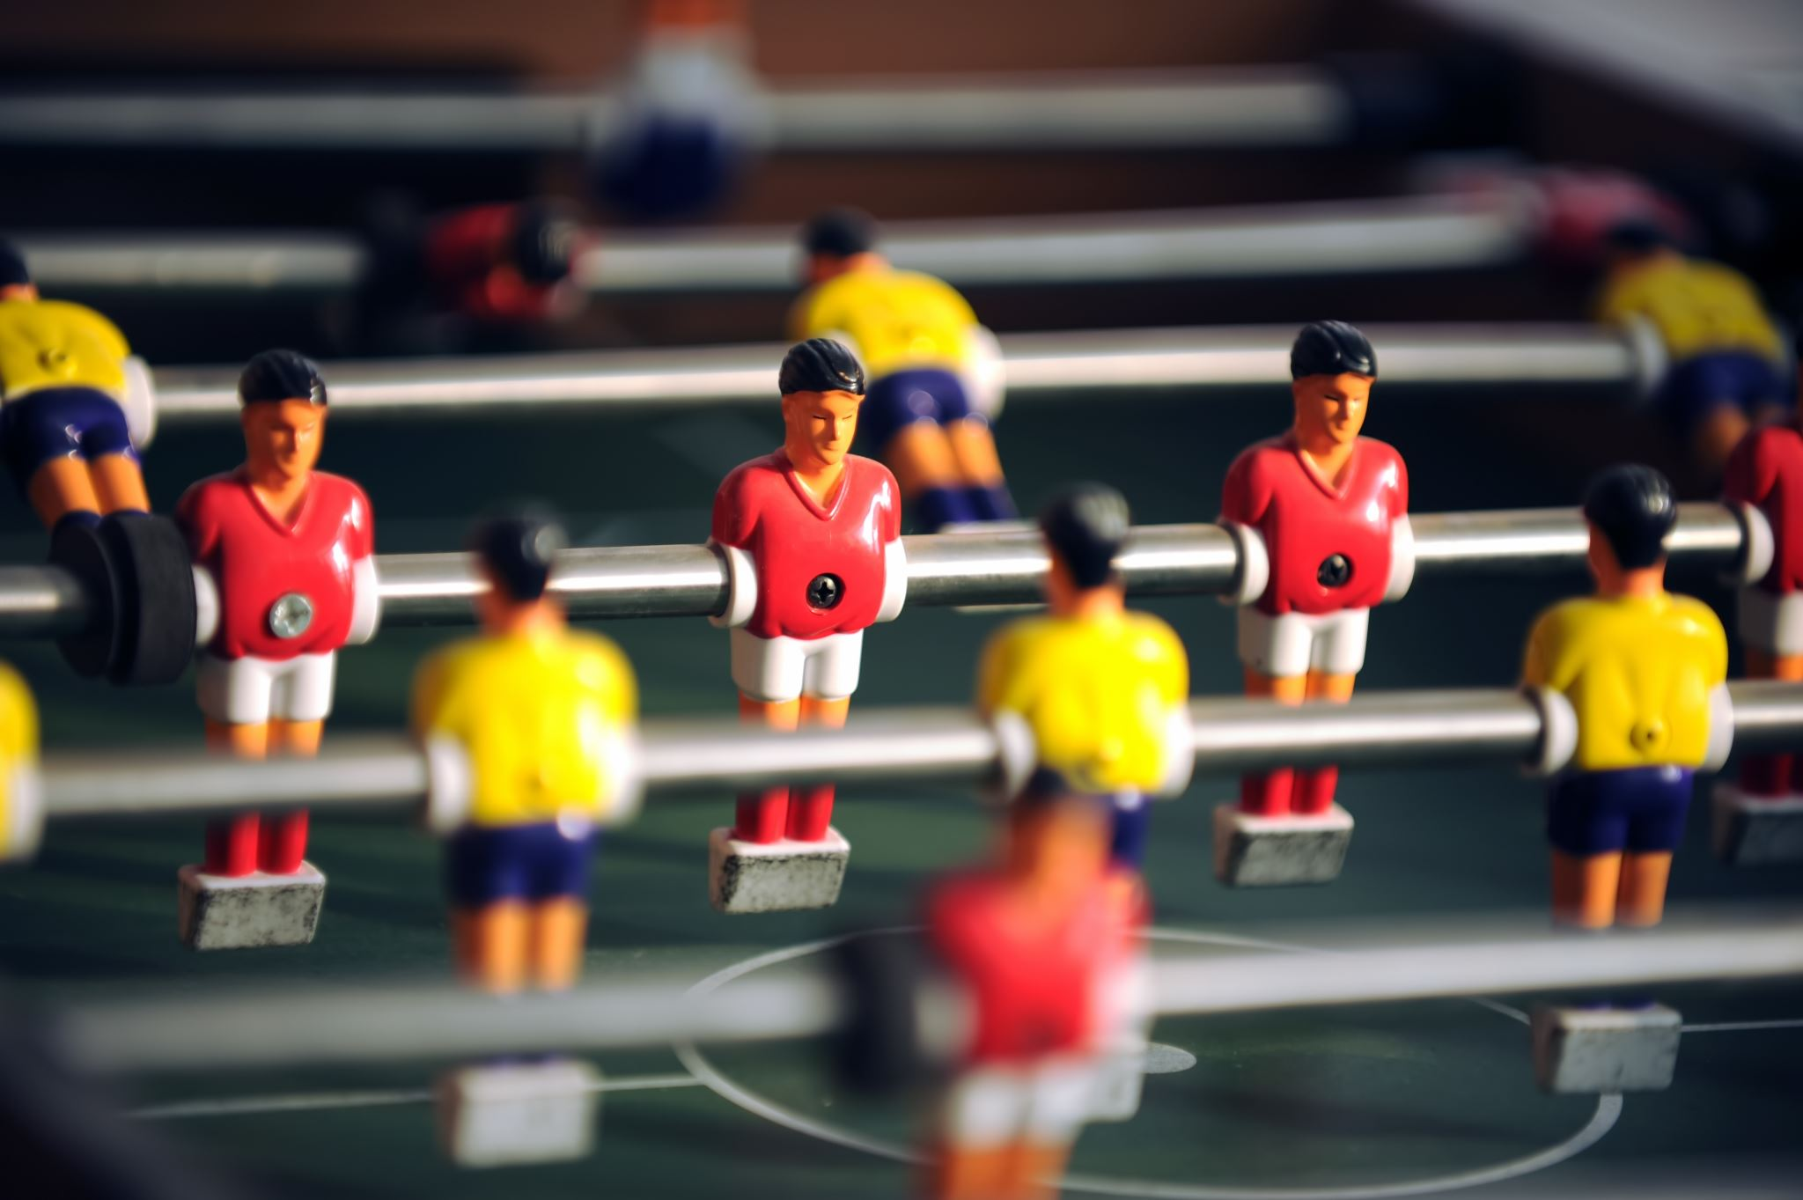
Dominant Strategies
A dominant strategy for a player is the one that yields the best payoff for that player no matter what the other player does. That is, a dominant strategy is a player’s best response to all the feasible strategies of the other player.

Slide 60
Dominant Strategy Equilibrium
In terms of the Prisoners’ Dilemma, both players have ‘confess’ as a dominant strategy, that is, in that case, each player’s best response would be to play confess regardless of what the other player might opt for. Thus we have (confess,Confess) as a dominant strategy equilibrium in the case of the Prisoners’ Dilemma.

Slide 61

Nash Equilibrium
Nash equilibrium refers to a set of mutually best response strategies, where each player chooses his best (optimal) strategy given the strategy of the other players.
Thus at Nash equilibrium, no player has an incentive to deviate from the chosen strategy, given the Nash equilibrium strategy of its rivals.

Slide 62
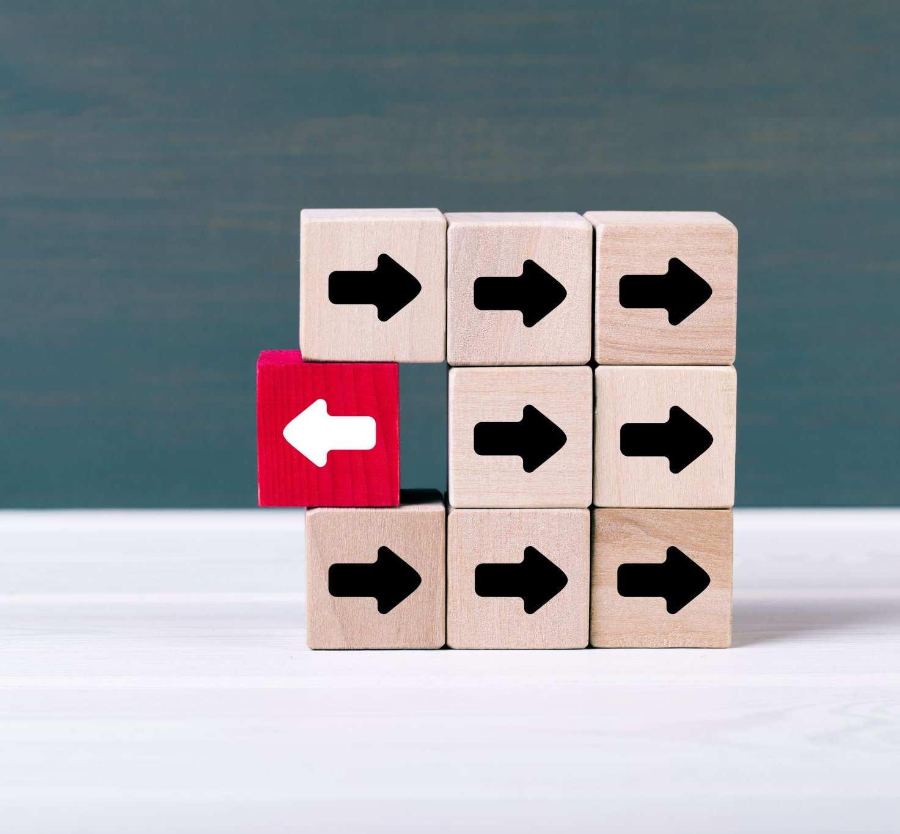
Mixed Strategies
In mixed strategies, players’ choice of strategies follows a probability distribution from among several possible strategies.

Slide 63
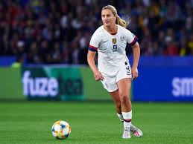
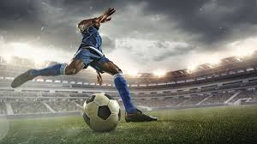
Case study : Penalty kicking in professional soccer
Where should top soccer players aim their penalty kicks?
At first glance, one might think that this is a matter of knowing the kicker’s strengths and the goalkeeper’s weaknesses. Most right-footed kickers are better at aiming to the left of the goal, or the goalkeeper’s right. On the other hand, more goalkeepers are more proficient at driving to their right. However, as soon as the kicker predictably kicks in one directionthe keeper can anticipate this and is more likely to make a save.
The key to success then for both players is to be unpredictable
and randomize their directions of shooting and diving.

Slide 64
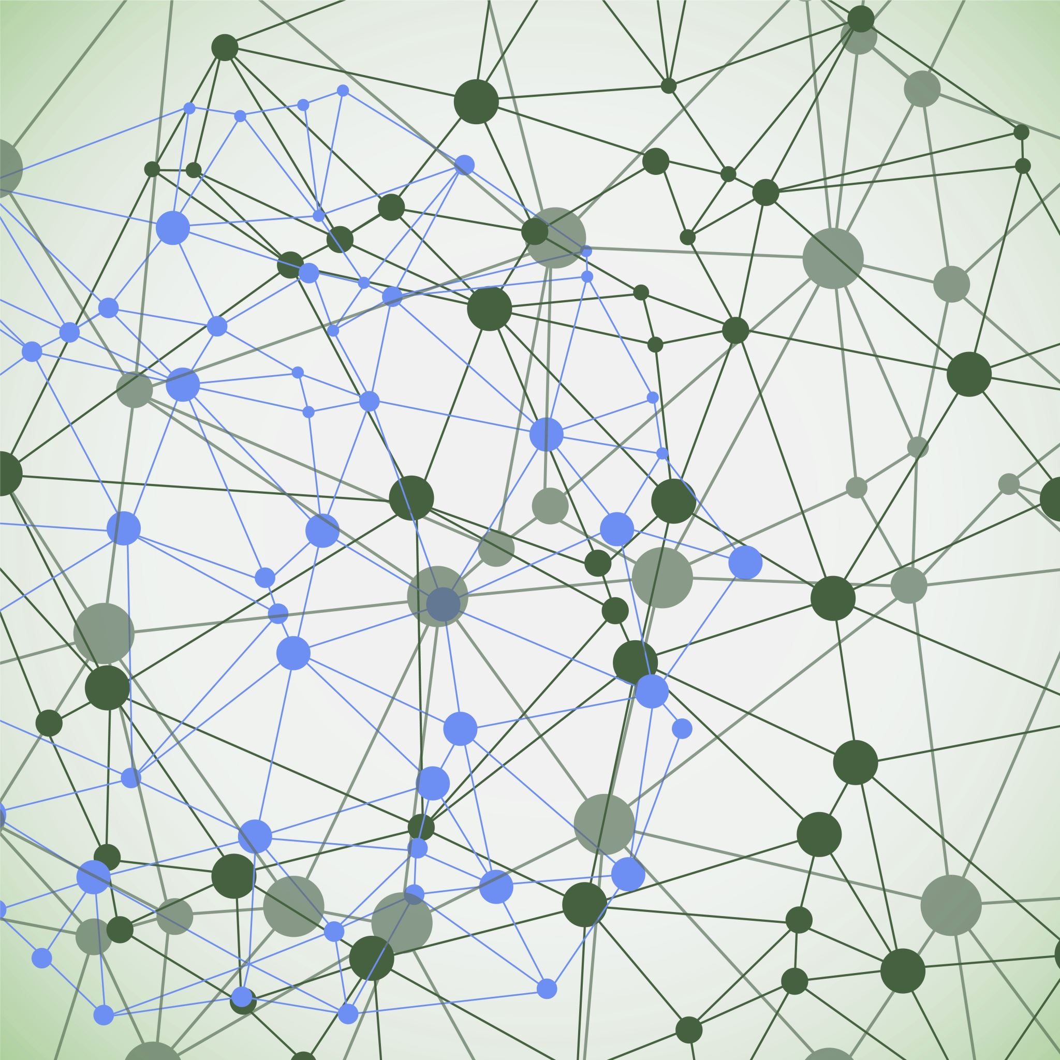
Bargaining
Bargaining refers to the process by which parties agree to the terms of a transaction.
Unstructured bargaining - This kind of bargaining allows the players to use any kind of communication, not restricting the type of message or the order of offers made.
Structured bargaining
The general nature of the structure used in experiments has been for the players to alternate offers over a finite or infinite period.

Slide 65
Structured bargaining
Structured bargaining follows predefined rules, frameworks, or institutional guidelines. It is usually formalized, and participants are aware of the procedures they must follow.
Characteristics:
Follows a systematic approach or institutional framework
Involves predefined negotiation rules
Often used in labor negotiations, legal disputes, or formal contracts
Outcomes are often predictable

Slide 66
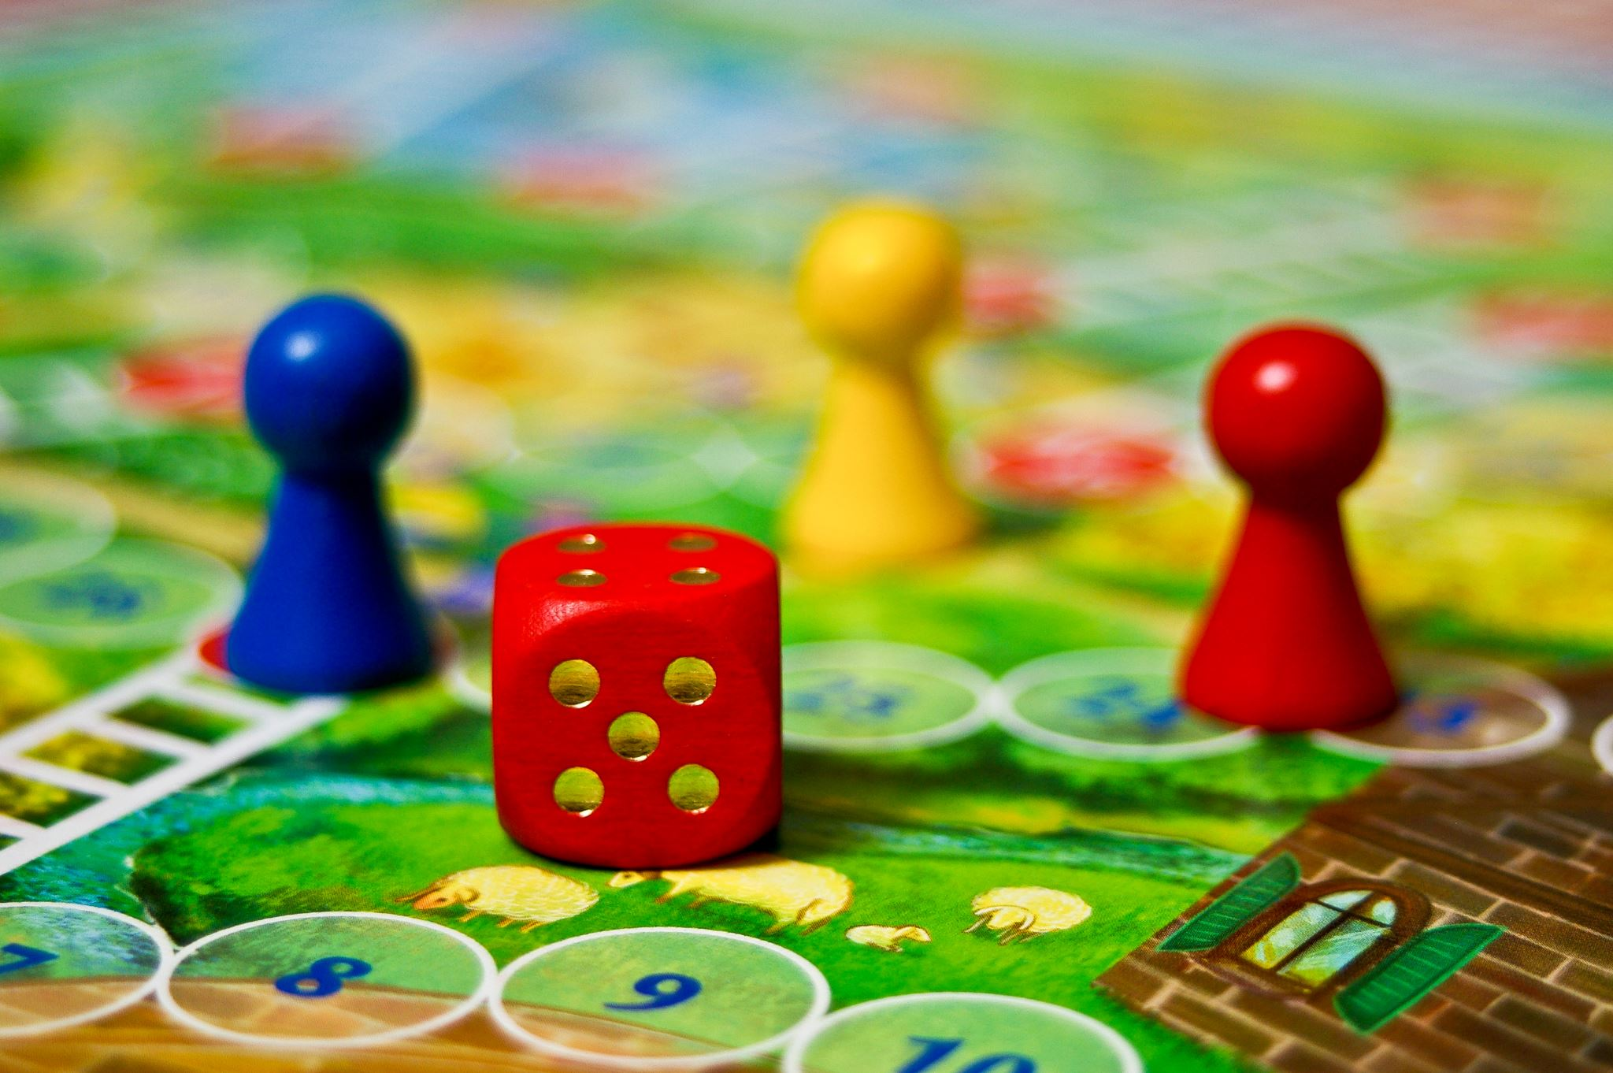
Example:
Union-Management Negotiations: In labor unions, bargaining between workers and management follows a structured process with rules regarding wages, working conditions, and dispute resolution.
Game-Theoretic Models: The Ultimatum Game is an example where one player (the proposer) offers a split of money, and the other (the responder) either accepts or rejects it, following a clear structure.

Slide 67
Unstructured Bargaining
Unstructured bargaining occurs in a more informal, flexible setting without strict rules. It is often influenced by emotions, cognitive biases, heuristics, and social norms.
Characteristics:
No fixed rules or formal procedures
More dependent on social interactions and negotiation skills
Often influenced by behavioral biases like anchoring, fairness concerns, or overconfidence
Common in everyday transactions

Slide 68
Example
Street Market Haggling: A customer negotiating the price of a product in an open market, where the final price depends on persuasion, perceived fairness, and psychological tactics.
Job Salary Negotiation: When a candidate negotiates their salary with an employer without a predefined structure, it depends on factors like confidence, framing, and negotiation skills.

Slide 69
Negotiation
“Negotiation is a discussion among the individuals to reach an alternative to satisfy all”.
“Discussion” here means simply the exchange of one’s ideas, thoughts and opinions with each other and not arguing.
One needs to have excellent communication skills and impressive personality for a healthy and an effective negotiation.
One should very sensibly convert his/her thoughts into a speech by carefully selecting relevant words.
Haphazard thoughts and abstract ideas only lead to confusions.
One should be crisp and precise in his/her speech.

Slide 70
P’s OF NEGOTIATION
Purpose : aim is required otherwise it will result in wastage of money, manpower & time.
Plan : main agenda on which negotiation is to be carried on.
Pace : main points should be covered in discussions; also proper breaks must be introduced to maintain interest of peoples involved.
Personalities : negotiator initiating negotiation must have convincing power, effective communication skills, can influence people & process of negotiation.

Slide 71
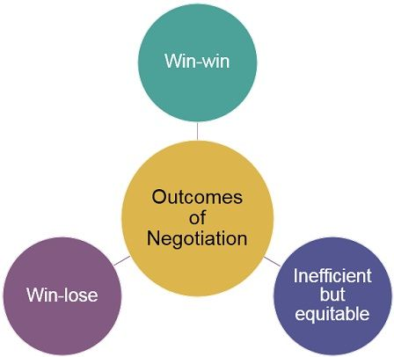
Results of negotiation

Slide 72
Monopoly
In the words of Prof. Chamberlain, “Monopoly refers to the control over supply.”
A monopoly is represented by a single seller who sets prices and controls the market.
The high cost of entry into that market restricts other businesses from taking part.
There is no competition and no product substitutes.

Slide 73
Barriers to entry
Economies of scale that lead to natural monopoly
control of a physical resource
legal restrictions on competition
patent, trademark and copyright protection
Practices to intimidate the competition like predatory pricing.

Slide 74
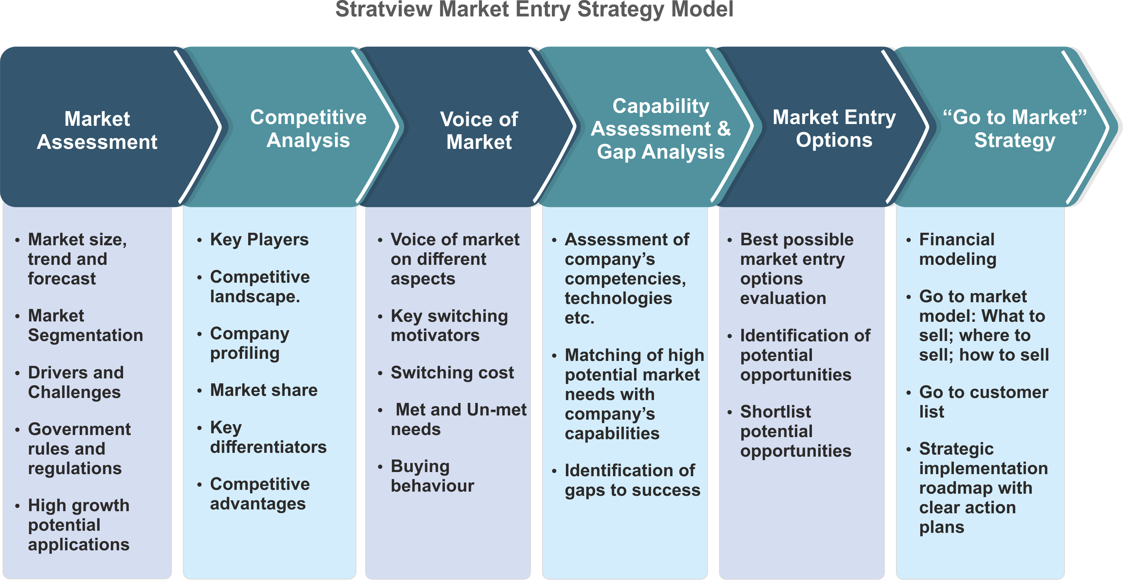
Market Entry Strategy Model

Slide 75


